Slide 1
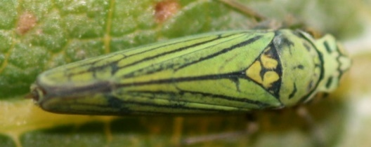
How does DSF production affect vector transmission?
Acquisition:
Test plant
BGSS
Needle
inoculation
DSF or WT
Test plant

Slide 2
Statistical model – mixed effects logistic regression
Probability of transmission = genotype +
distance from inoculation +
Xf pop in vector +
interactions +
plant random effect

Slide 3
Statistical model
Probability of transmission = genotype +
distance from inoculation +
Xf pop in vector +
interactions +
plant random effect

Slide 4
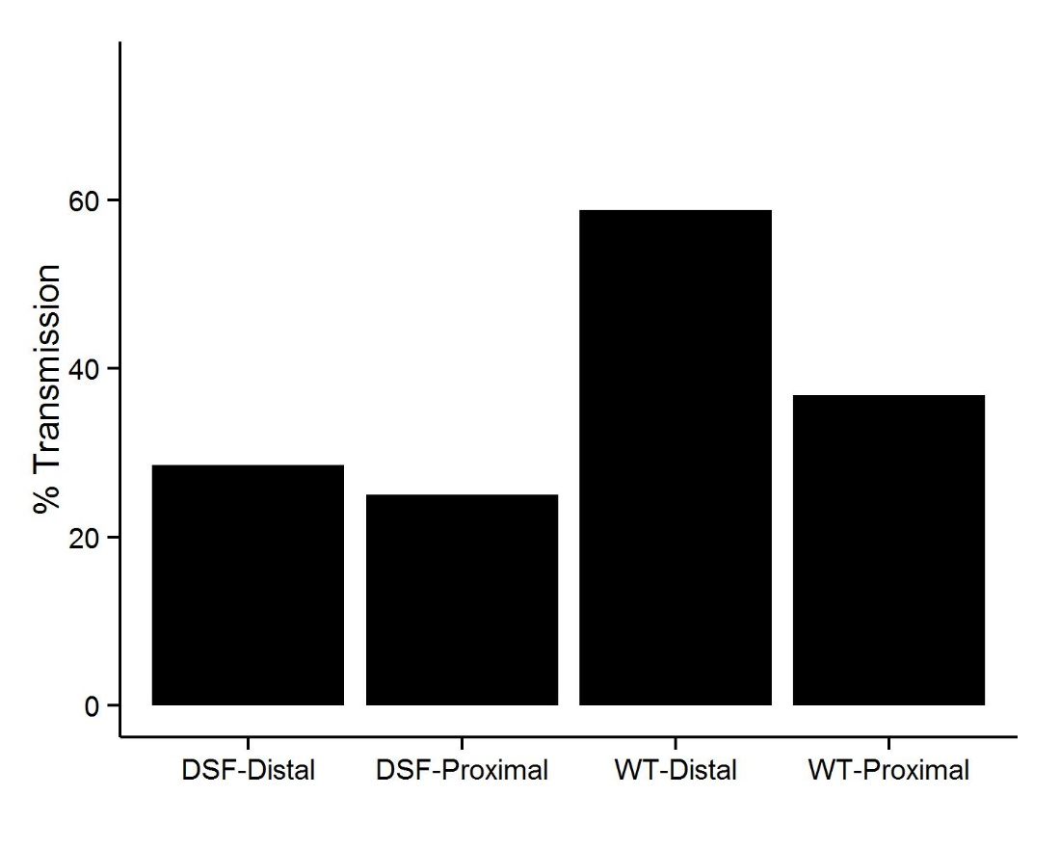
No statistical difference between genotypes
DSF or WT
n = 21 20 17 19

Slide 5
Xf pops in vector vs. Transmission
WT
Significant positive relationship
(P = 0.01)
No interaction with genotype
DSF

Slide 6
Statistical model – including source plant Xf pops
Probability of transmission = genotype +
distance from inoculation +
Xf pop in vector +
Xf pop in source plant +
interactions +
plant random effect

Slide 7
Xf pop in source plant vs. Transmission
DSF
Marginally significant main effect relationship
(P = 0.0669)
WT
Reduced sample size:
 | Distal cage | Proximal cage
DSF | 16 | 14
WT | 9 | 13

Slide 8
Distance from inoculation vs. Xf pop in source plant
WT
Significant main effect
(P = 0.011)
DSF
Xf in source plant = genotype +
distance from POI +
interaction +
plant random effect

Slide 9
Xf pop in source plant vs. Xf pop in vector
Significant main effect
(P = 0.0198)
DSF
Xf in vector= genotype +
xf in source plant +
interaction +
plant random effect
WT

Slide 10
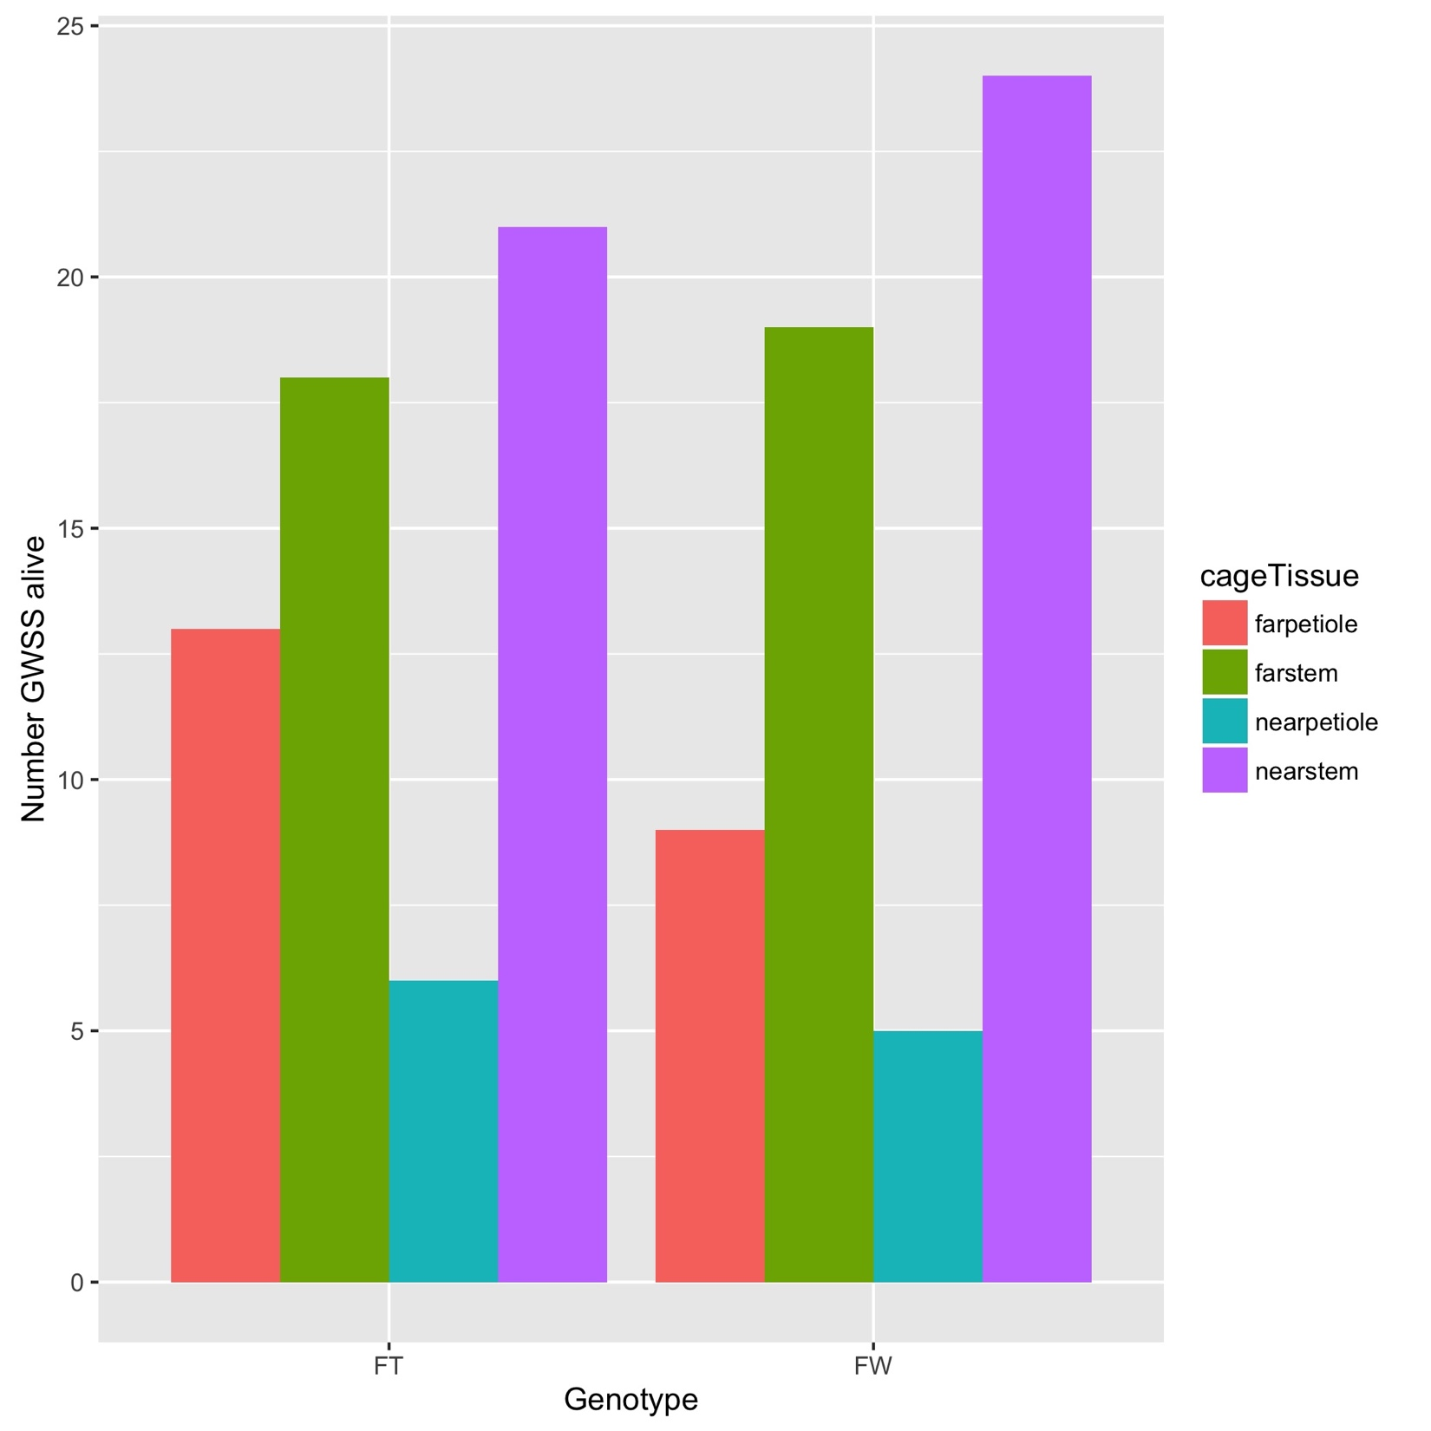
Transmission from DSF plants by GWSS

Slide 11
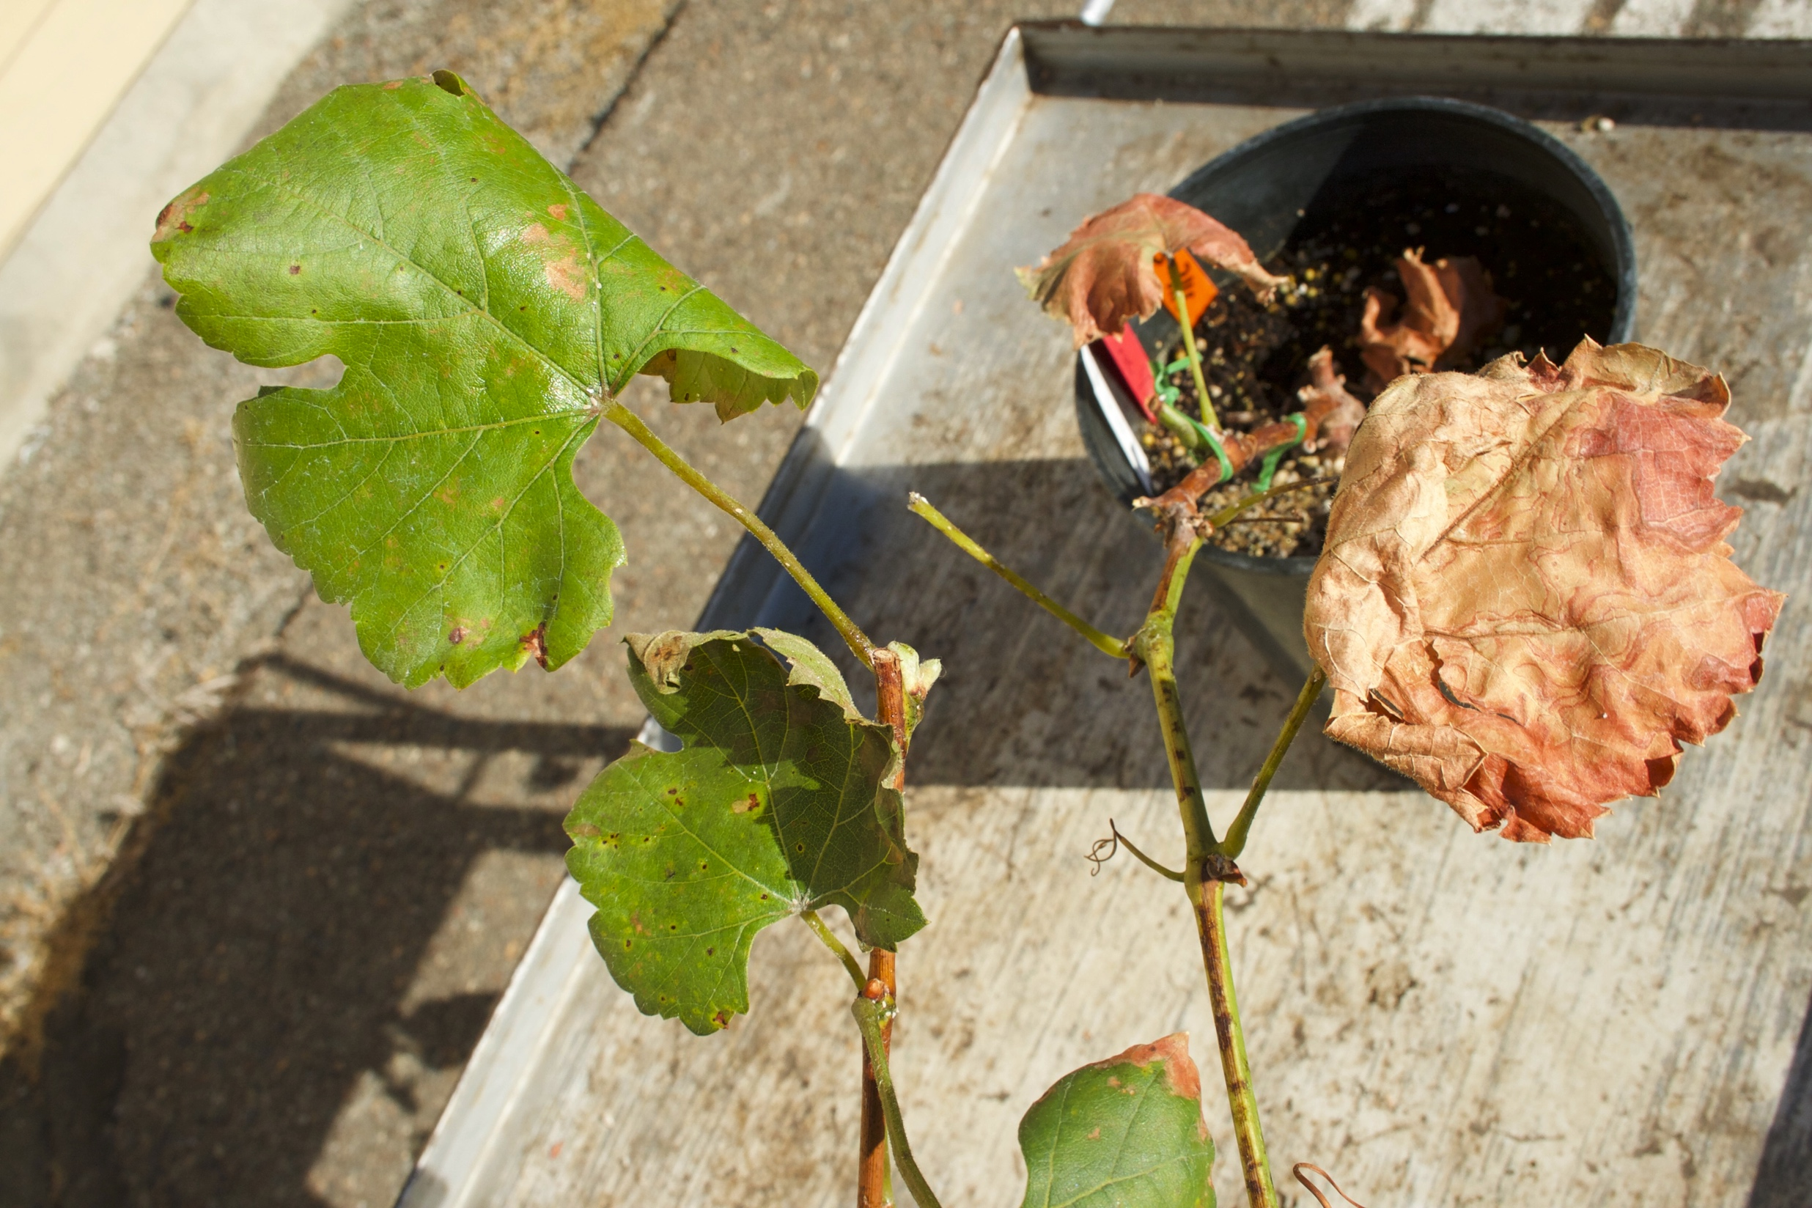
Transmission and vector preference experiment – PdR1 hybrid plants
(Vitis rupestris x V. arizonica) x V. vinifera cv. Airen

Slide 12
Transmission and vector preference experiment – PdR1 hybrid plants
R*
R*
R*
x 8
S
S
S
S*
S*
S*
x 8
S
S
S
3 weeks
post-inoculation
8 weeks
12 weeks
8 non-infectious BGSS per cage

Slide 13
Estimating vector preference from Consumer Movement Model
Infected
plant
Neutral
space
Xf-free
plant
p_{i}
p_{x}
P_{infected}
P_{n}
P_{Xf-free}
μ_{i}
μ_{x}

Slide 14
Four model variants tested:
Free Model | p_{i} ≠ p_{x} μ_{i} ≠ μ_{x}
Free Attraction Model | p_{i} ≠ p_{x} μ_{i} = μ_{x}
Free Leaving Model | p_{i} = p_{x} μ_{i} ≠ μ_{x}
Fixed Model | p_{i} = p_{x} μ_{i} = μ_{x}

Slide 15
Vector preference
over time

Slide 16
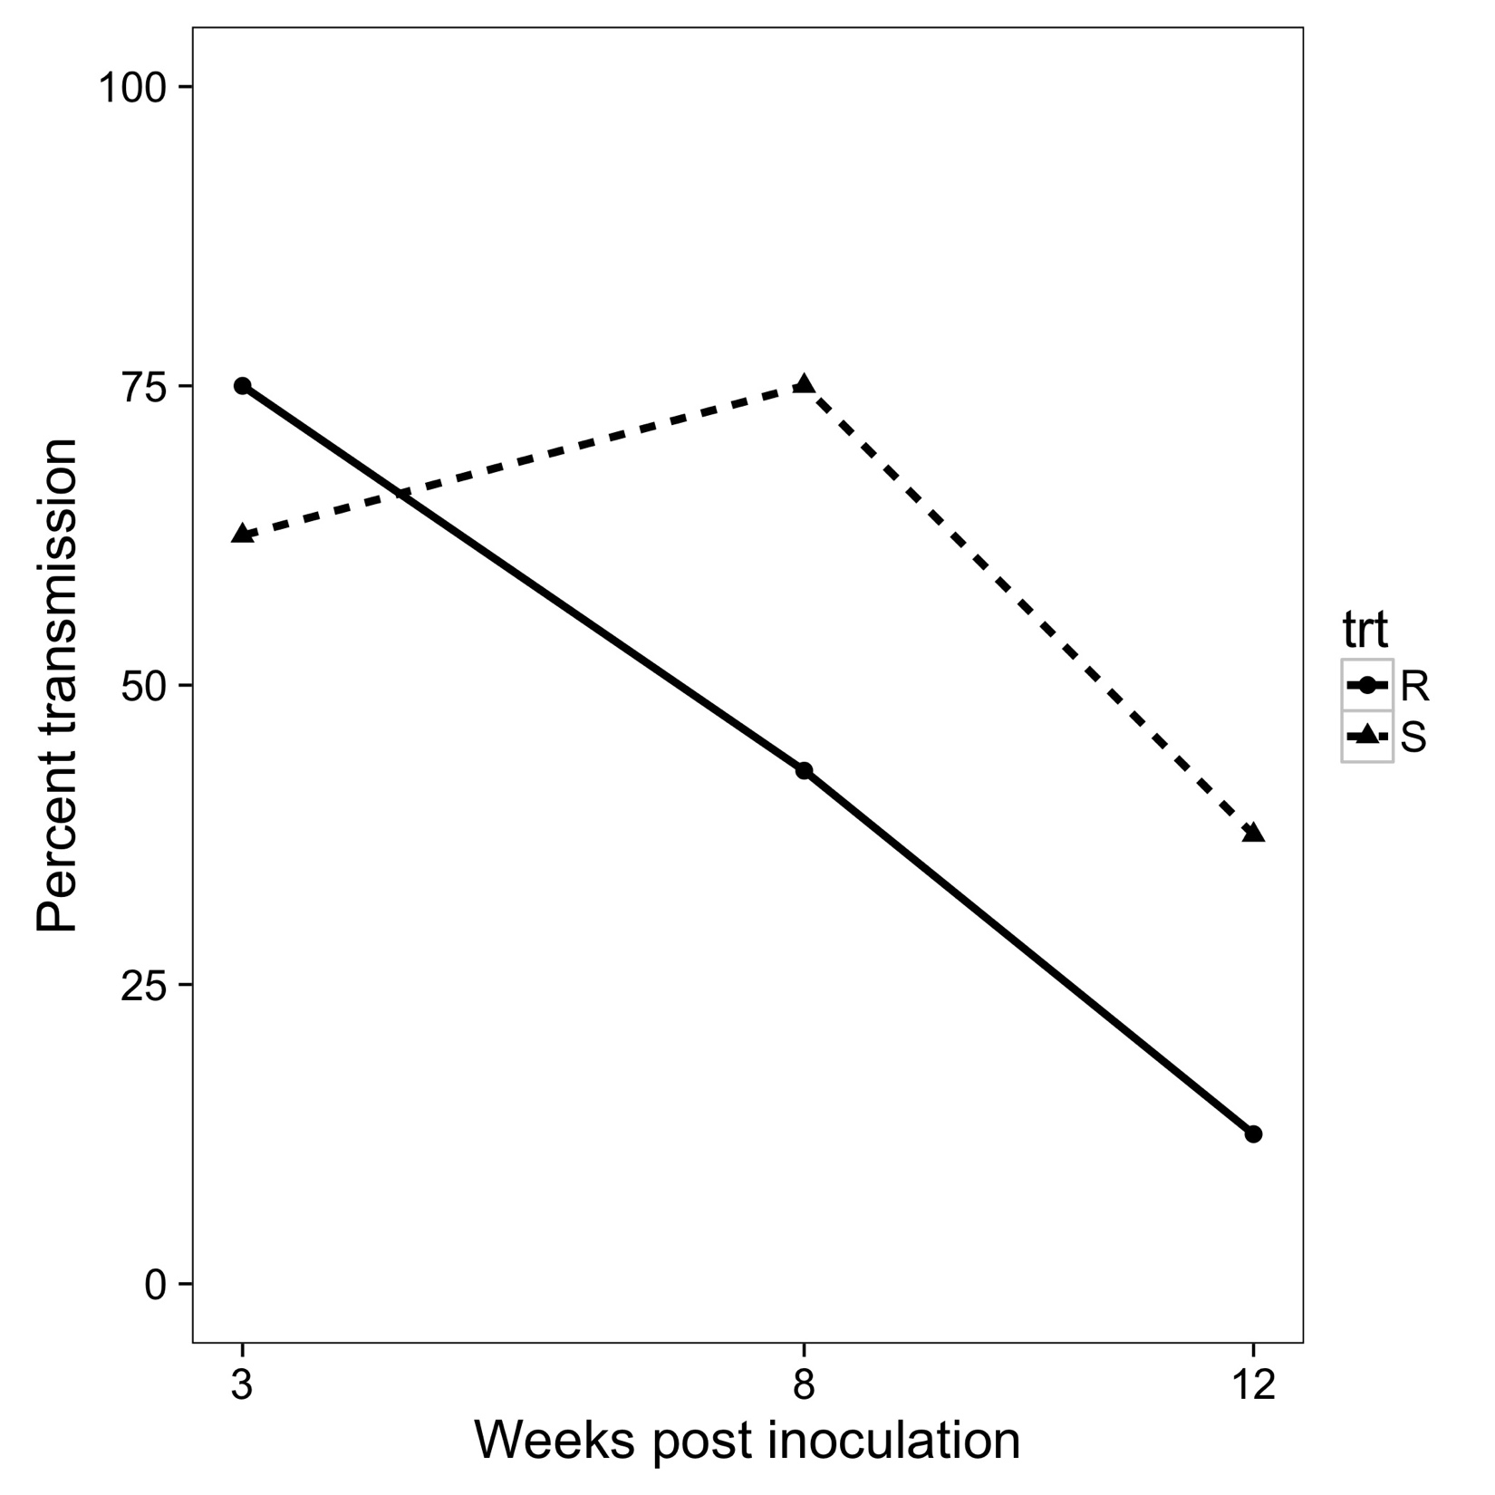
Transmission results
Significant decline in transmission
over time (P = 0.021)
No difference between genotypes
No significant interaction
Leaving rate from infected plant was best preference parameter to explain transmission
S
R

Slide 17
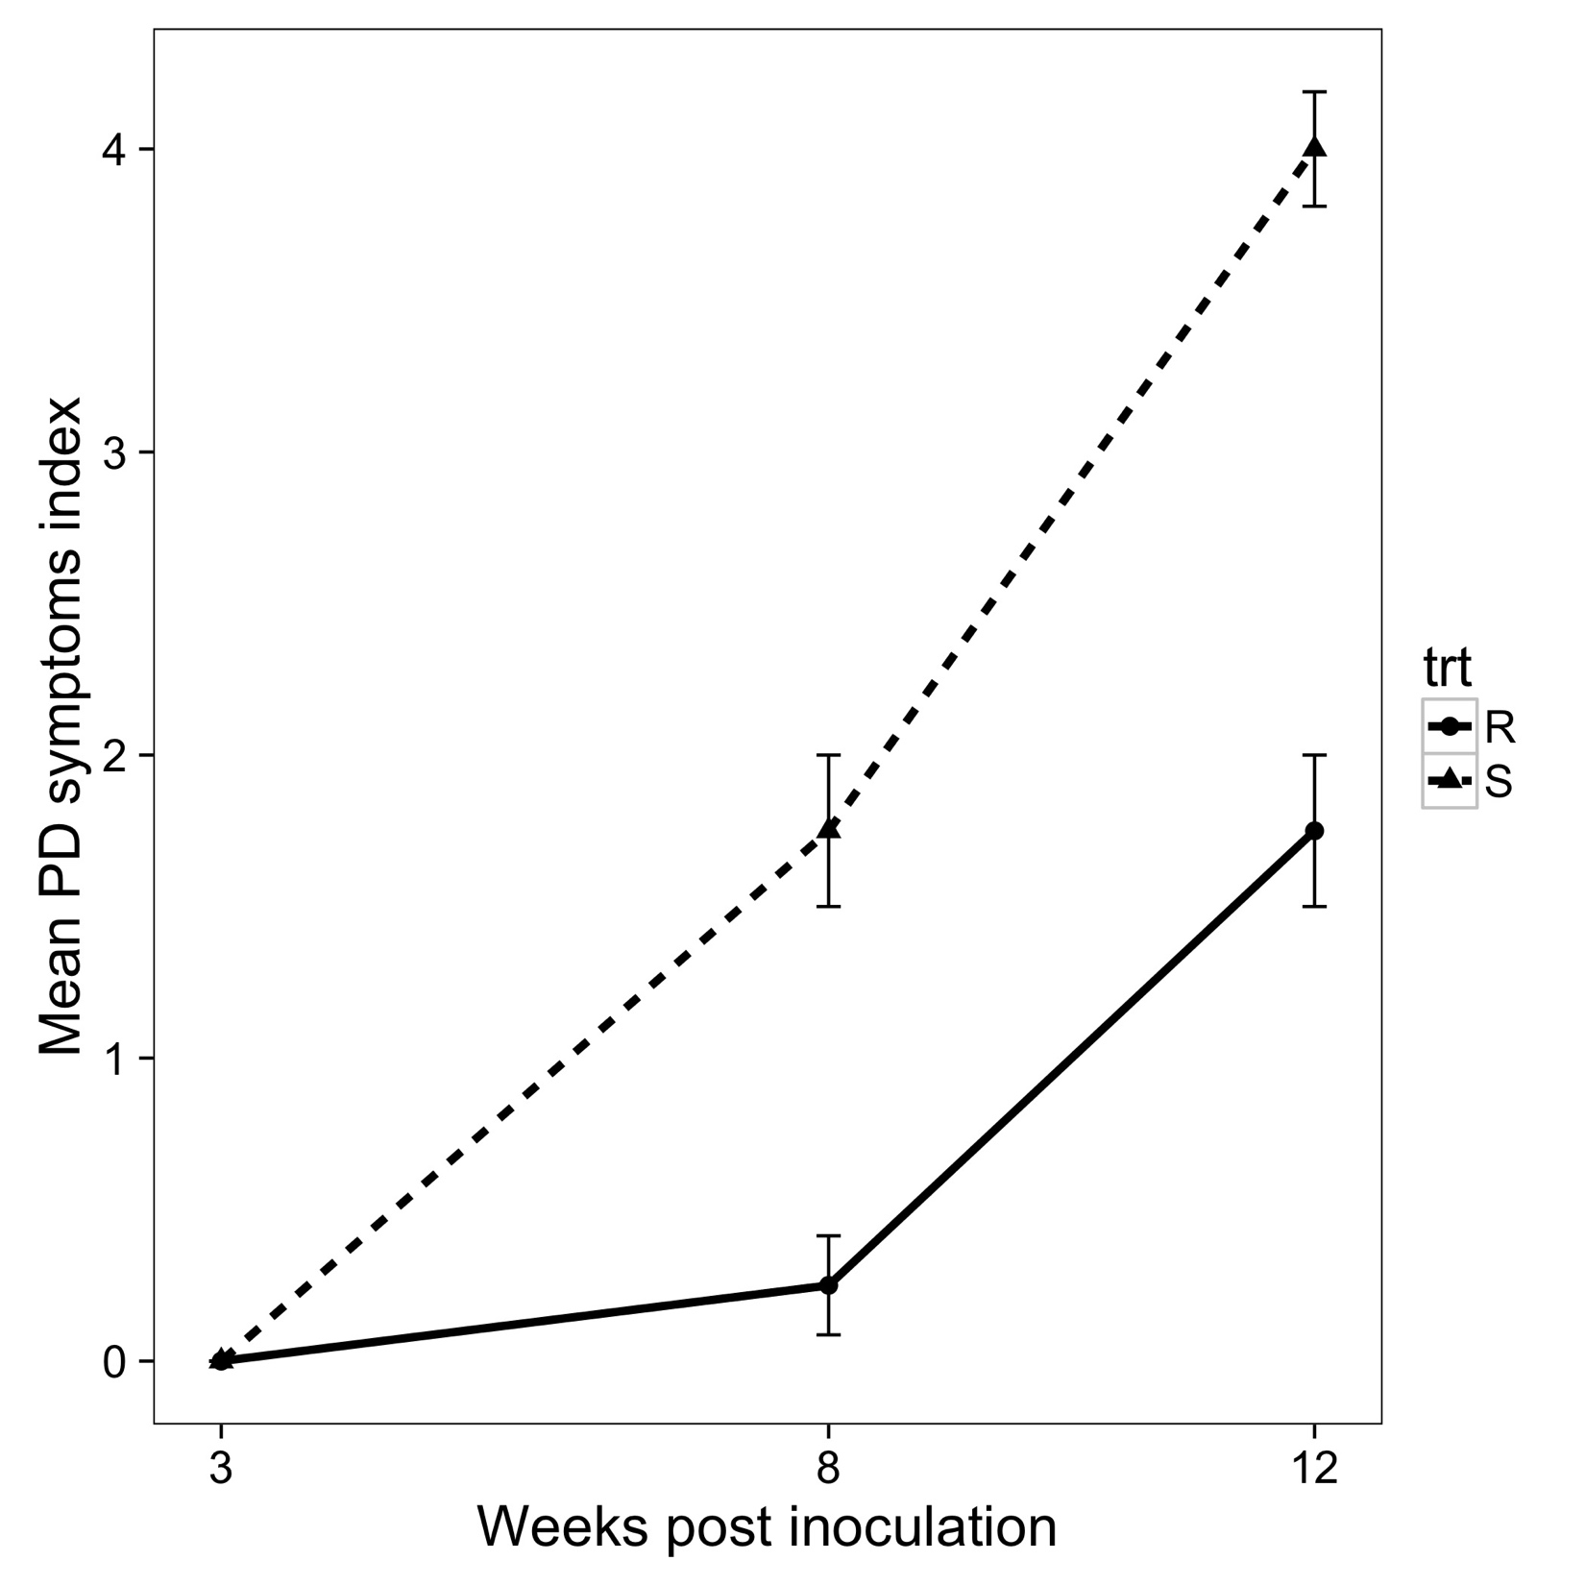
PD symptoms
Significant increase over time
(P = 0.044)
Marginal difference between genotypes
(P = 0.056)
Marginal interaction
Marginal relationship to Xylella populations
S
R

Slide 18
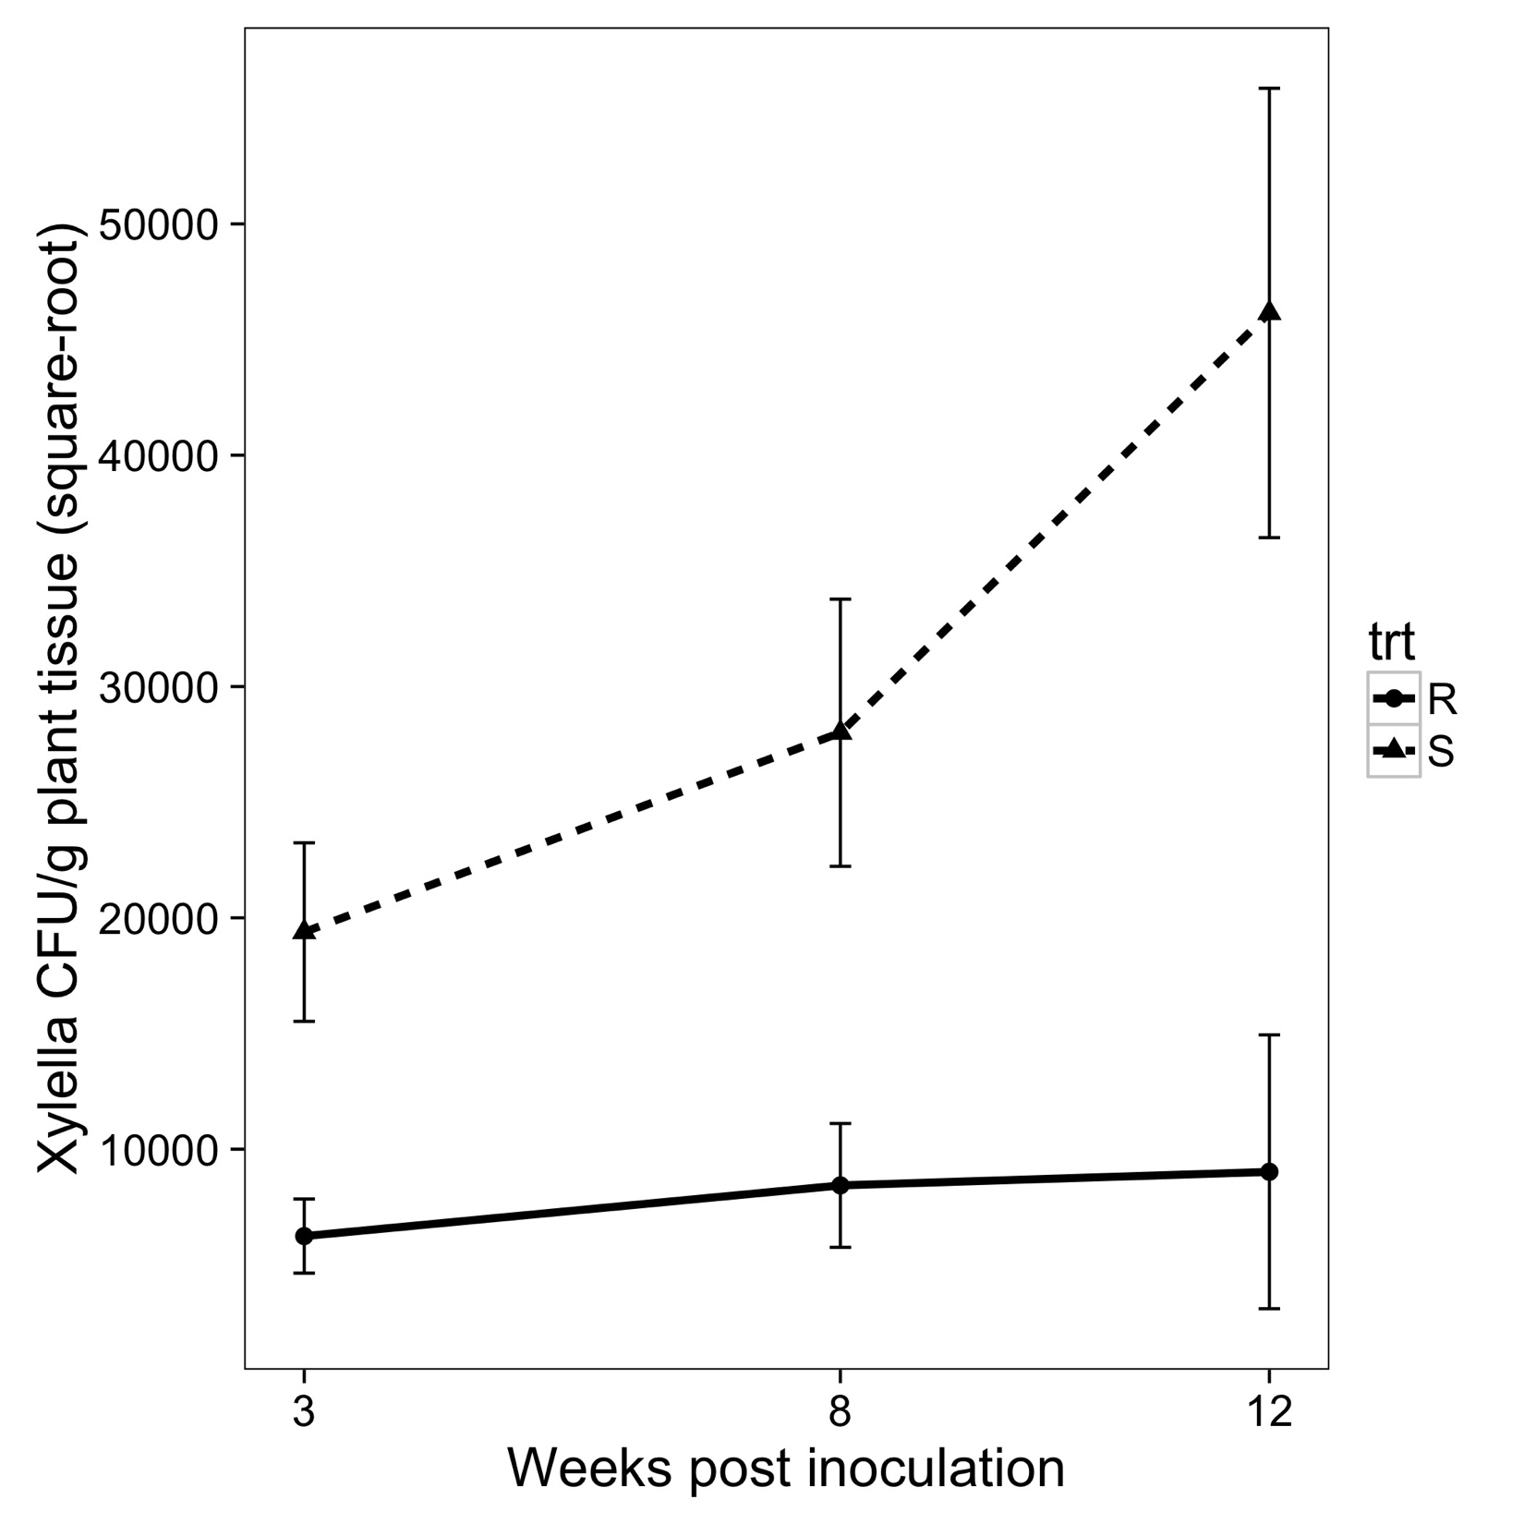
Xylella populations
No significant main effects
Significant interaction (P = 0.039)
S
R

Slide 19
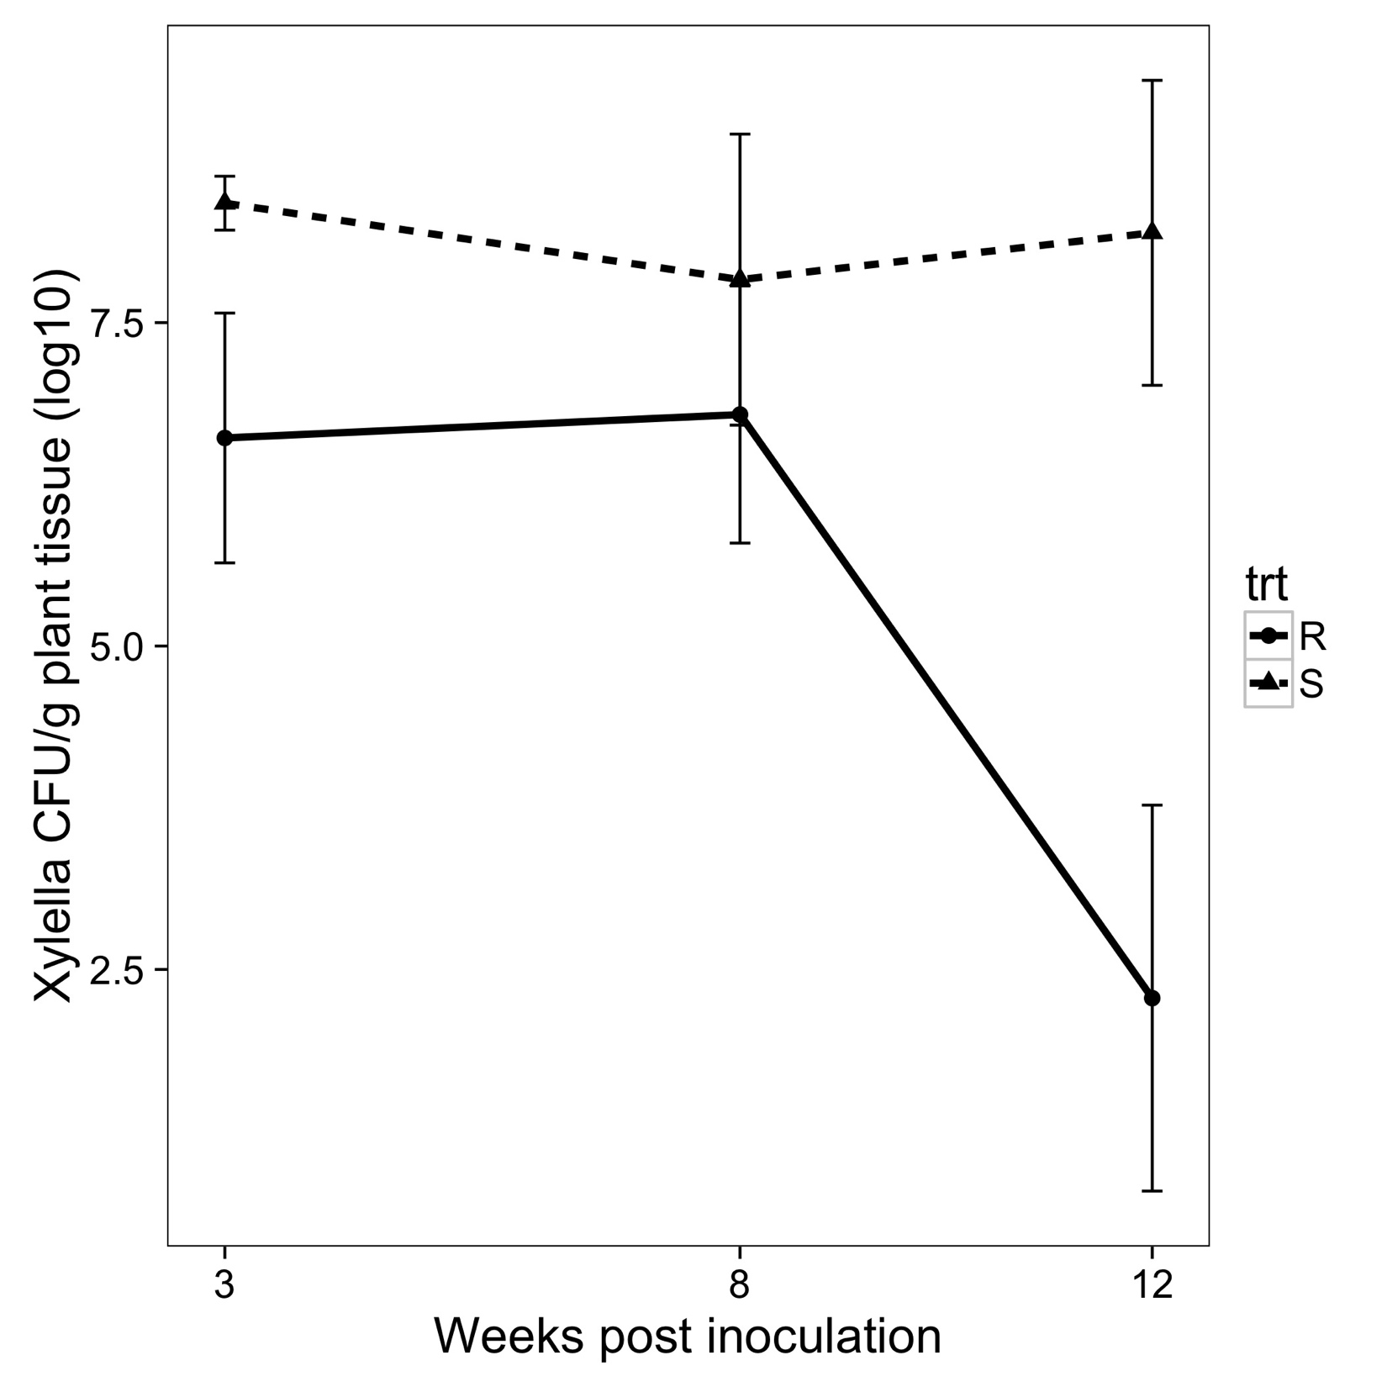
Xylella populations
S
Significant decline over time
Marginally significant interaction
R

Slide 20
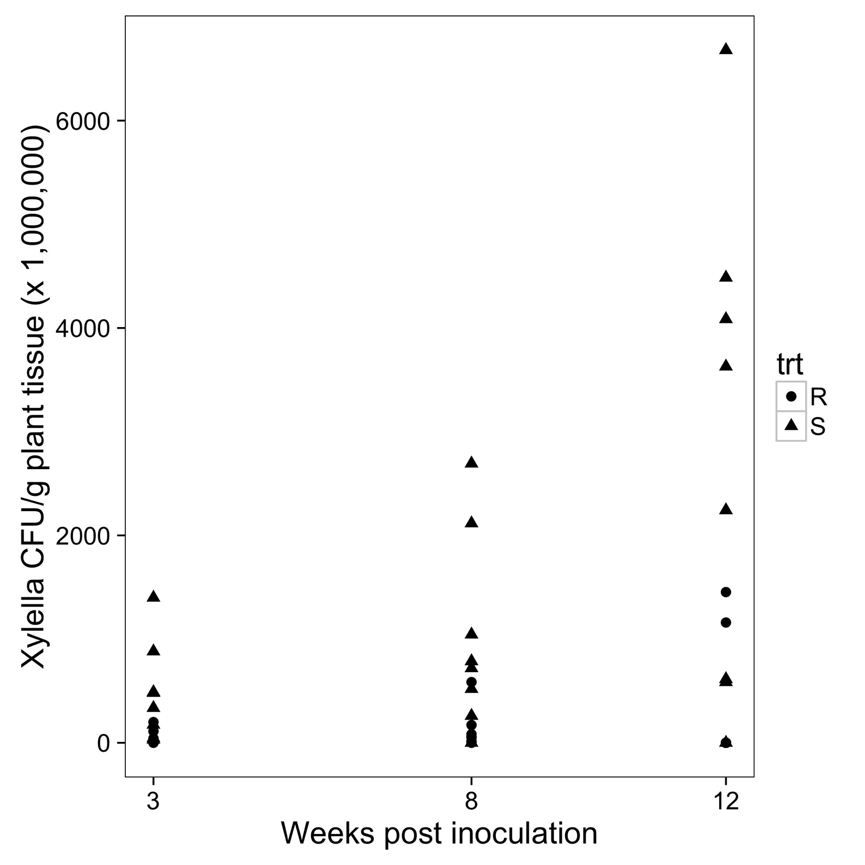
Xylella populations
S
S
Significant decline over time
No significant interaction
R
R

Slide 21
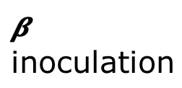
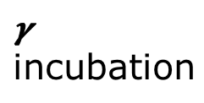

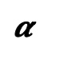
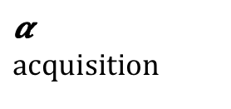
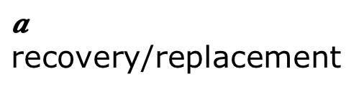

Modeling experimental results
$$a$$
recovery/replacement
Host
S
E
C
pI
$$δ$$
latent
$$γ$$
incubation
$$β$$
inoculation
$$α$$
$$α$$
$$acquisition$$
preference
V
U
Vector
$$μ$$
recovery

